Slide 1


2 Sensors
EOE Postgraduate Courses
Multi-sensor Data Fusion
wangjingqi@njust.edu.cn

Slide 2
Contents
2.1 Introduction
2.2 Smart Sensor
2.3 Logical Sensors
2.4 Interface File System
2.5 Sensor Observation
2.6 Sensor Characteristics
2.7 Sensor-Sensor Properties
2.8 Sensor Model

Slide 3
2.1 Introduction
Sensors are devices
interact directly with the environment
ultimately the source of all the input data in a multi-sensor data fusion system
perceiving a physical property, or environmental attribute, such as heat, light, sound, pressure, magnetism or motion.
outputting a quantitative measurement in a consistent and predictable manner.

Slide 4
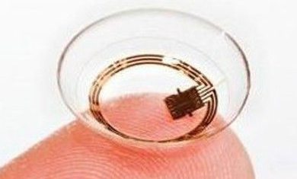
Sensors
not only measuring a physical property, but also perform additional functions:
Compensation. ⎯ the ability of a sensor to detect and respond to changes in the environment through self-diagnostic tests, self-calibration and adaption.
Information Processing . ⎯ processes such as signal conditioning, data reduction, event detection and decision-making, which enhance the information content of the raw sensor measurements.
Communications. ⎯ the use of a standardized interface and a standardized communication protocol for the transmission of information between the sensor and the outside world.
Integration. ⎯ the coupling of the sensing and computation processes on the same silicon chip, often implemented using microelectro-mechanical systems (MEMS) technology.

Slide 5
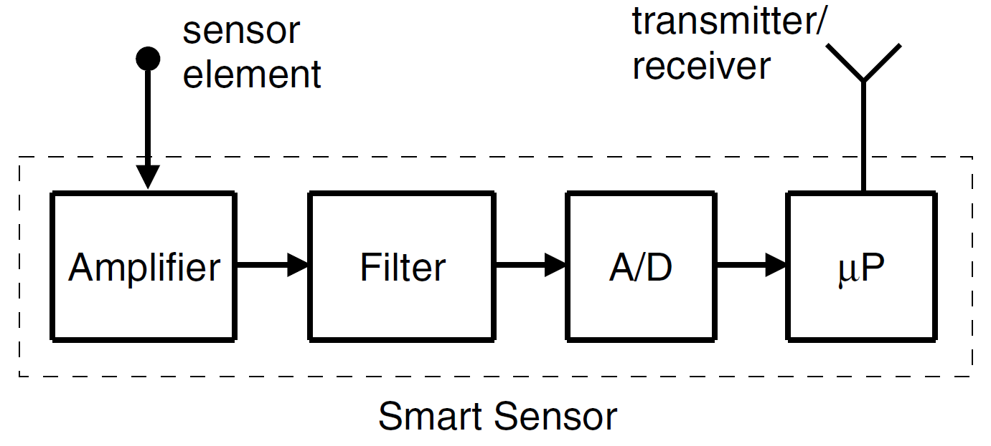
2.2 Smart Sensor
A smart sensor is a hardware/software device that comprises in a compact small unit a sensor element, a micro-controller, a communication controller and the associated software for signal conditioning, calibration, diagnostic tests and communication.
Fig. 2.1 Measurement of a physical property by a smart sensor.
The sensor element measures the physical property and outputs an analog signal.
The analog signal is amplified, filtered and then converted to a digital signal.
The digital signal is processed by the microprocessor, μP, temporally stored before being transmitted by the transmitter/receiver.

Slide 6
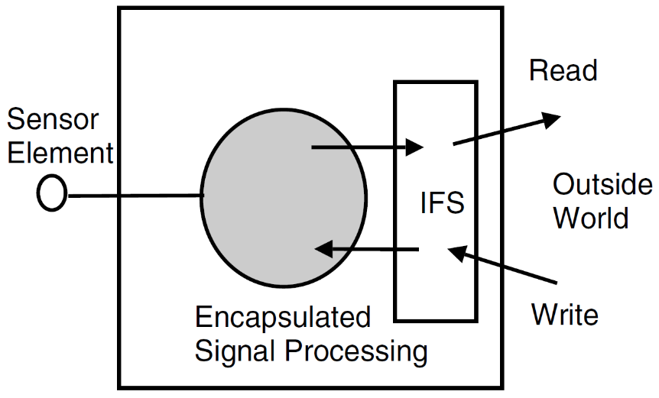
Interface-file system (IFS)
The transfer of information between a smart sensor and the outside world is achieved by reading (writing) the information from (to) an IFS
IFS is encapsulated in the smart sensor as shown in Fig. 2.2.
Fig. 2.2 Transfer of information between a smart sensor and the outside word.

Slide 7
2.3 Logical Sensors
A logical sensor is defined as any device which functions as a source of information for a multi-sensor data fusion node.
contains both physical sensors and any fusion node whose output is subsequently fed into another fusion node.
Unless stated otherwise, from now on the term “sensor” will refer to a logical sensor or a source-of-information.

Slide 8
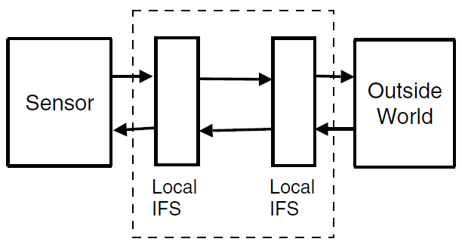
2.4 Interface File System (IFS)
Interface File System provides a structured space which is used for communicating information between a smart sensor and the outside world.
Example 2.1. Brake Pedal in a Car: An Interface File System.
the brake pedal acts as an IFS between the driver and the brakes.
P: the pressure applied to the brake pedal by the driver
R: the resistance provided by the brakes back to the driver.
relative position of the brake pedal → P & R
A record of the IFS can be accessed, both from the sensor and from the outside world.
Often IFS acts as a temporal firewall between the sensors and the outside world.
Fig. 2.3 IFS acts as a temporal firewall.

Slide 9
2.4.1 Interface Types
Real-time Service (RS) Interface.
providing time sensitive information to the outside world.
sensor observations made on real-time entities in the environment.
accessing real-time IFS files usually time-critical.
Diagnostic and Maintenance (DM) Interface.
parameterization and calibration at start-up, and the periodic collection of diagnostic information to support maintenance activities.
accessing diagnostic IFS files not usually time critical.
Configuration and Planning (CP) Interface.
configuring a smart sensor for a given application.
including the integration and set-up of newly connected sensor modules.
accessing the configuration IFS files not usually time-critical.

Slide 10
2.4.2 Timing
possible communication and computational schedule:
Event Triggered. All communication and processing activities are initiated whenever a significant change of state occurs.
Time Triggered. Activities are initiated at pre-determined times.
Time-triggered architecture (TTA)
preferred for safety-critical real-time applications for its deterministic.
relying on the synchronization of all local clocks to a global clock: pre-determined time instants are a priori known to all nodes.
☹ not ensure that events in a distributed system can be consistently ordered.
Example 2.2. Ordering Events in a Distributed Network.
two local clocks c and C.
events occurring in a sequence: local clock c ticks, event e occurs, local clock C ticks.
The event e is time-stamped by the two clocks with a difference of one tick.

Slide 11
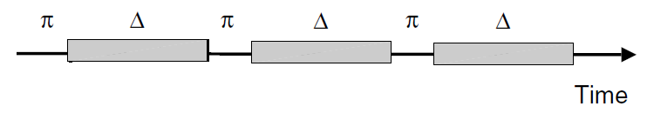
Sparse time base :
partitioning the continuum of time into an infinite sequence of alternating durations of activity (duration π) and silence (duration Δ).
ensuring that significant events occur only during an interval of activity.
Events occurring during the same segment of activity are considered to have happened at the same time.
Events that are separated by at least one segment of silence can be consistently assigned to different time-stamps for all clocks in the system.
Fig. 2.4 The sparse time based used in the time-triggered architecture.
π denotes the intervals of activity and Δ denotes the intervals of silence. If δ is the precision of the clock synchronization, then we require Δ > π > δ.

Slide 12
2.5 Sensor Observation
A small “window”
Physical property is continuously in time and value
A “snapshot” → output is reduced to a single scalar value
sensor observation
Entity-Name E ⎯ the name of the physical property, and the units in which it is measured.
Spatial Location x ⎯ the position in space. Spatial location is sometimes defined implicitly as the position of the sensor element.
Time Instant t ⎯ the time of a measurement. In real-time systems it is often as important as the measurement value itself.
Measurement y ⎯ the value of the physical property, may having more than one dimension→vector. All values are given in digital representation.
Uncertainty Δy ⎯ a generic term including different types of errors in y. measurement eooros, calibration errors, loading errors, and environmental errors.

Slide 13



Symbolical Representation
using 5-tuple
(2.1)
When the observation is censored and we represent the missing fields by an asterisk (∗). e.g., if the spatial location x is missing ,
(2.2)
Example 2.3. Time-of-Flight Ultrasonic Sensor. (ToF)
In a ToF, the sonar transducer emits a short pulse of sound and then listens for the echo.
The measured quantity is the time between the transmission of the pulse and reception of the echo which is converted to a range reading r .
The corresponding sensor observation is
where range reading r is one-half of the distance traveled by the sound pulse. Δr is the uncertainty in r.

Slide 14

Example 2.4. A Digital RGB (Color) Image.
a digital RGB (color) image I is characterized by an array of pixel gray-levels.
At any pixel x, the pixel gray-level g(x) is a vector of three values (R,G,B). Let x denote the relative position of pixels,
where G denotes the array of g(x) values.

Slide 15
2.5.1 Sensor Uncertainty Δy
Random Errors
characterized by a lack of repeatability.
caused by measurement noise.
E.g., due to fluctuations in the capacity of the resistance of the electrical circuits in the sensor, or due to the limited resolution of the sensor.
Systematic Errors
characterized by being consistent and repeatable.
Calibration errors: a result of error in the calibration process, and often due to linearization of the calibration process for devices exhibiting non-linear characteristics.
Loading errors: arising if the sensor is intrusive, which alters the measurand.
Environmental Errors: arising from the sensor being affected by environmental factors which are not taken into account.
Common Representation Format Errors. occurring when the original sensor space reverted to a common representational format.

Slide 16
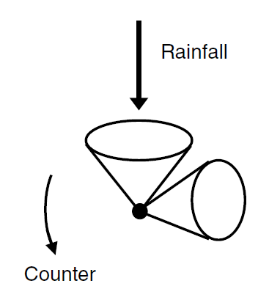

Example 2.5. Systematic Errors in a Tipping-Bucket Rain Gauge.
Rain-gauges are relatively accurate instruments.
“undercatchment”: at high rain intensities, part of the water is not “catched” by the tipping-bucket mechanism.
systematic error ！
may be corrected using the following calibration curve:
Fig. 2.5 A tipping-bucket rain-gauge.
A tipping-bucket rain-gauge. This consists of two specially designed buckets which tip when the weight of 0.01 inches of rain falls into them. When one bucket tips, the other bucket quickly moves into place to catch the rain. Each time a bucket tips, an electronic signal is sent to a recorder.
where y is the actual rain intensity, y_{G} is the rain-gauge measured intensity and α and β are two calibration parameters.

Slide 17
Spurious Readings
non-systematic measurement errors.
an error occurs when a sensor detects an obstacle at a given location x when, in fact, there is no obstacle at x.
Example 2.6. Spurious Readings in Time-of-Flight Ultrasonic Sensor.
In a time-of-flight ultrasonic sensor, the sensor calculates the distance r to the nearest obstacle from the measured time between the transmission of a pulse and the reception of its echo.
Sometimes the sensor will detect an obstacle at a given range r when, in fact, there is no object at r.
This can happen if the sensor receives a pulse emitted by second sensor and interprets the pulse as if it were its own pulse.

Slide 18
2.6 Sensor Characteristics
State.
Internal sensors: devices used to measure “internal” system parameters, such as position, velocity and acceleration.
potentiometers, tachometers, and accelerometers.
External sensors: devices used to monitor the system’s geometric and/or dynamic relation to its tasks and environment.
strain gauges and ultrasonic, pressure and electromagnetic sensors.
Function.
classified in terms of their functions, i. e. in terms of the parameters, or measurands, which they measure.
In the mechanical domain, the measurands include displacement, velocity, acceleration, dimensional, mass and force.

Slide 19
Performance.
classified according to their performance measures, including accuracy, repeatability, linearity, sensitivity, resolution, reliability and range.
Output.
classified according to the nature of their output signal: analog (a continuous output signal), digital (digital representation of measurand), frequency (use of output signal’s frequency) and coded (modulation of output signal’s frequency, amplitude or pulse).
Energy Type.
classified according to the type of energy transferred to the sensor.
thermal energy involves temperature effects in materials, including thermal capacity, latent heat and phase change properties
electrical energy involves electrical parameters, such as current, voltage, resistance and capacitance

Slide 20
2.7 Sensor-Sensor Properties
Distributed. Sensors which give information on the same environment but from different points of view or from different subsets of the environment.
Complementary. Sensors which together perceive the whole environment but which individually only perceive a subset of the environment.
Heterogeneous. Individual sensors which give data with completely different characteristics and types.
Redundant. Sensors which perceive the same environment or phenomenon, with little differences between them.
Contradictory. Sensors with the same definition space, but which provide very different information about the same entity.
Concordant. Sensors which provide compatible information concerning the environment, i. e. they corroborate each other.

Slide 21
Discordant. Sensors which provide incompatible information concerning the environment.
Different Granularity. Sensors which provide redundant data but which observe the environment at different scales.
Synchronous/Asynchronous. Sensors which provide data which are temporally concordant or not.
A given set of sensors may possess more than one of above relationships!
Example 2.7. Physiological Measurements.
We consider two physiological measurements made on a given patient: temperature and blood pressure. The measurements are provided by two sensors: a thermometer and a tensiometer.
The two data sources are distributed, complementary and heterogeneous as defined on the physiological space of the patient.

Slide 22
2.8 Sensor Model
a coherent description of the sensors ability to extract information from its surroundings.
sensor model within the general “background information” I.
the variable Θ which we are interested in, and a sensor measurement y.
N raw sensor measurements y_{i}, i ∈ {1, 2, . . .,N}→ directly observed
the variable of interest Θ→not directly observed and must be inferred.
In mathematical terms, inferring Θ → estimating the a posteriori probability, P(Θ = θ|y, I),
θ — the true value of the variable Θ
y = (y₁^{T} , y₂^{T} , . . . , y_{N}^{T} )^{T} ⎯ the vector of N sensor measurements.
Bayesian viewpoint ⎯ assuming that all the available information concerning Θ is contained in p(Θ = θ|y, I) .

Slide 23
A priori probability
the probability that would express one's beliefs about this quantity before some evidence is taken into account
“Priori”→ before taking into account the relevant evidence related to the particular case being examined
e.g. the relative proportions of voters who will vote for a particular politician in a future election
Posterior probability
the conditional probability that is assigned after the relevant evidence is taken into account
“Posterior”→ after taking into account the relevant evidence related to the particular case being examined
e.g. the conditional proportions of voters who will vote for a particular politician in a future election after a survey

Slide 24
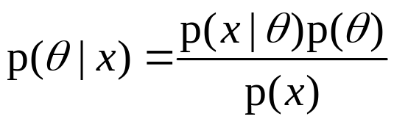
Likelihood
a function of the parameters of a statistical model given data
likelihood≠probability
Probability：before data are available to describe possible future outcomes given a fixed value for the parameter
Likelihood：after data are available to describe a function of a parameter for a given outcome
Bayes’ Rule
Posterior probability ∝ Likelihood × Prior probability

Slide 25
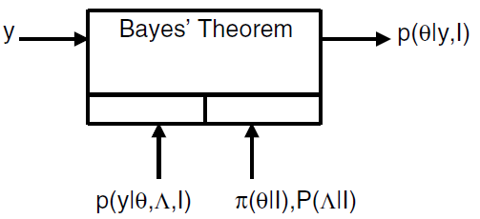

Faulty sensor model
A Priori pdf π(θ|I).
a continuous probability density function to describe our a priori beliefs about θ.
often assuming that π(θ|I) is a Gaussian distribution with a mean value μ₀ and a covariance matrix Σ₀:
(2.3)
Fig. 2.6 Faulty sensor model.
Sensor Reliability P(Λ|I).
a discrete probability distribution to specify the a priori sensor reliability.
Simplest model→2 states: Λ = {λ₀, λ₁}, where λ₀ denotes fault-free operation and λ₁ denotes faulty operation, where ordinarily P(Λ = λ₀) ≈ 1.
Λ=(Λ₁, Λ₂,…, Λ_{N})^{T}, where Λ_{i} denotes the status of the sensor when it makes the ith measurement y_{i}.
Likelihood p(y|θ, Λ, I).
a continuous function to describe how measurements y depend on the true value θ, the background information I and the sensor status Λ.

Slide 26

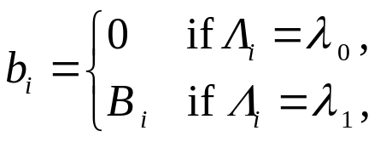

Example 2.8. Integrity Monitoring in a Satellite Navigation System.
Integrity monitoring refers to the detection and isolation of faulty measurement sensors.
consider a system described by a linear Gaussian model :
y = (y₁^{T} , y₂^{T} , . . . , y_{N}^{T} )^{T} denotes the vector of N sensor measurements,
θ = (θ₁ , θ₂ , . . . , θ_{M} )^{T} is the unknown vector of navigation parameters,
H is a known N ×M measurement matrix,
b(Λ) = (b₁(Λ₁), b₂(Λ₂), , . . . , b_{N}(Λ_{N}))^{T} is a vector of unknown measurement biases which we describe using the following two-state model:
w = (w₁, w₂, . . ., w_{N})^{T} is a vector of random measurement noise with a zero-mean Gaussian pdf for w:

Slide 27
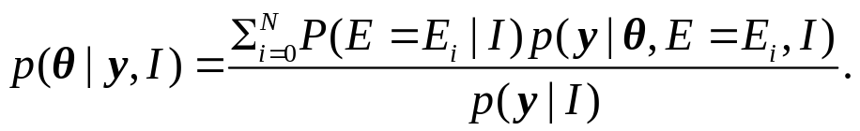
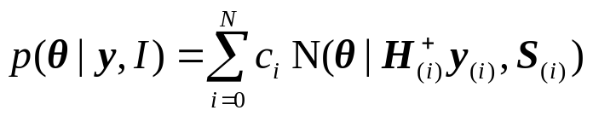
Assume that multiple failure do not occur. The a posteriori pdf p(θ|y, I) can be written as a sum over all E_{i} :
E_{i} ⎯the case of a failure in the ith measurement
E₀⎯ the case of no failures.
H_{(i)} and y_{(i)} ⎯the matrix H and the vector y with the ith row removed,
Σ_{(i)} ⎯ the covariance matrix Σ with the ith row and column removed,
p(θ|y,I) describes the a posteriori distribution of the unknown vector θ.
c_{i} describes the integrity or relative probability that the ith measurement is in error.

Slide 28
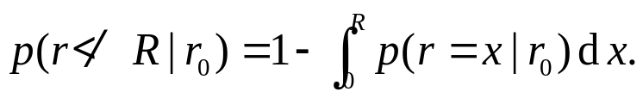
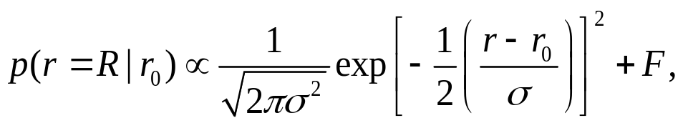
Example 2.9. Konolige Model for a Time-of-Flight Ultrasonic Sensor .
Obtaining a range reading of a time-of-flight ultrasonic sensor, equal to R. Then the fault-free (i.e. Λ= λ₀) likelihood function is p(r◦R|r₀), where r◦R denotes that the first detected echo corresponds to a distance R (“r=R”) and that no return less than R was received (“r≮ R”).
Let p(r=R|r₀) and p(r≮R|r₀) denote the conditional pdfs corresponding to r=R and r≮R, then the likelihood function for a time-of-flight ultrasonic sensor is
where,
To a good approximation,
where F is a small constant which takes into account multiple targets which may reflect the sonar beam, in addition to the target at r₀.

Slide 29
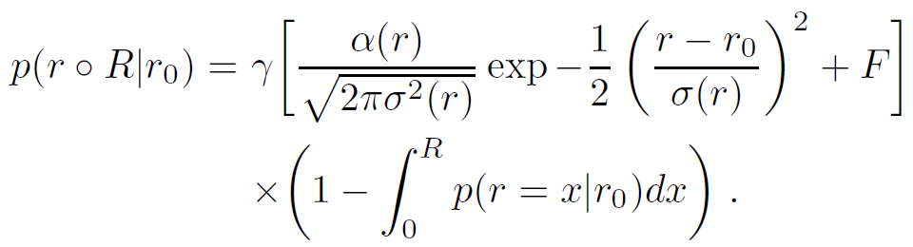
The range error becomes proportionally larger and the probability of detection becomes proportionally smaller at increasing range. Incorporating this effects into the above likelihood function we obtain the Konolige likelihood function:
where γ is a normalization constant, α(r) describes the attenuation of the
detection rate with increasing distance and σ(r) describes the increase in the range variance with increasing distance.

Slide 30

Thank you for your attention!

